Slide 1

Project Report
Hrithik Tanwar 2K18/EE/085
Ishan Budhiraja 2K18/EE/087

Slide 2
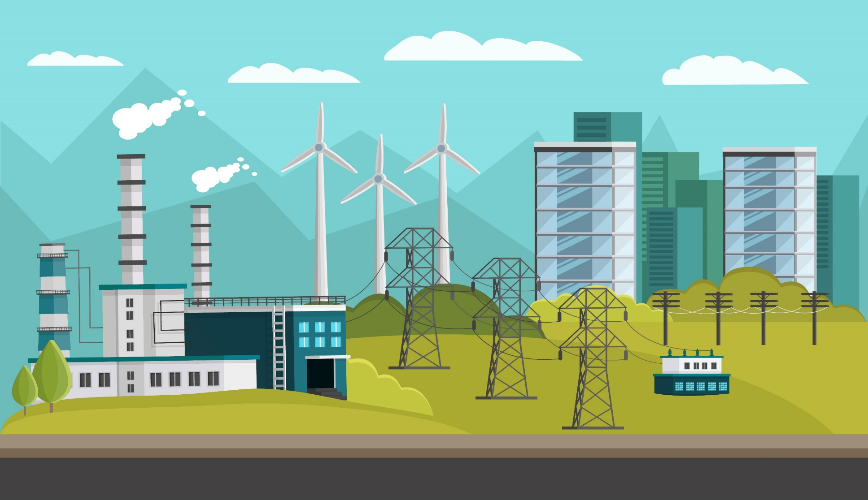
Power System Deregulation

Slide 3
Project analysis slide 2
Table of Contents
1 | INTRODUCTION
2 | COMPONENTS INVOLVED IN DEREGULATIOM
3 | STRUCTURE OF DEREGULATION
4 | REGULATED AND DEREGULATED INDUSTRY
5 | THE MARKETPLACE MECHANISM
6 | MARKET MODELS
7 | ELECTRICITY ACT 2003
8 | DEREGULATION OF POWER SYSTEMS IN INDIA
9 | CONCLUSION

Slide 4
Project analysis slide 2
Introduction
Deregulation- Electric deregulation is the process of reforming the rules and regulations that govern the energy industry by allowing competition to give consumers the option of suppliers of electricity that are either retailers or traders. Deregulation increases the economic efficiency of electricity output and use. Power rates are expected to decline due to competition in the energy market, which benefits customers.
Main Objectives
To provide electricity for all reasonable demands.
The promotion of "competition" in electricity generation and supply.
To boost supply reliability and the quality of services.
To foster the power system's productivity and economy.
Benefits
Capacities in systems can be used effectively.
Energy supply optimization will take place.
Electricity rates may become simpler.
The selection of consumers will be increased.
Bad technologies are avoided, and in their place, successful technologies are replaced.

Slide 5
Project analysis slide 2
Components Involved in Deregulation
GENCOS
PX
DEREGULATION
TRANSCOS
RESCOS
DISCOS
ISO

Slide 6
Project analysis slide 2
Components Involved in Deregulation
1.Genco (Generating Company): Genco is an owner-operator of one or more generators that runs them and bids the power into the competitive marketplace
2.Transco (Transmission Company): Transco moves power in bulk quantities from where it is produced to where it is delivered.
3.Disco (Distribution Company): It is the monopoly franchise owner-operator of the local power delivery system, which delivers power to individual businesses and homeowners.
4.Resco (Retail Energy Service Company): It is the retailer of electric power. Many of these will be the retail departments of the former vertically integrated utilities.
5.Independent System Operator (ISO): The ISO is an entity entrusted with the responsibility of ensuring the reliability and security of the entire system.
6.Power Exchangers (PX): PX handles the electric power pool, which provides a forum to match the electric energy Supply and demand based on auction prices

Slide 7
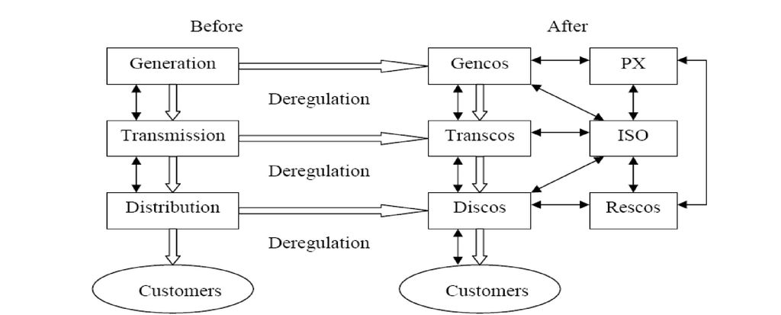
Project analysis slide 2
Structure of Deregulation Environment

Slide 8
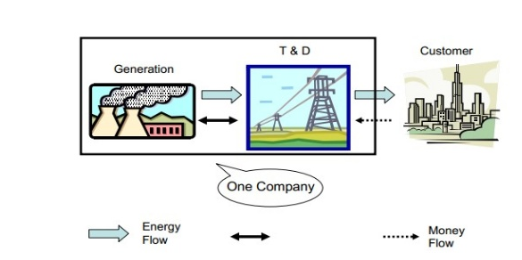
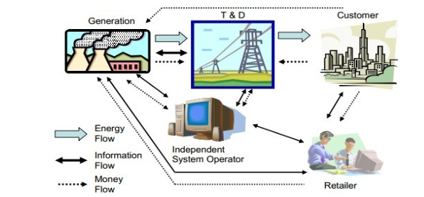
Project analysis slide 8
REGULATED AND DEREGULATED INDUSTRY
REGULATED INDUSTRY
DEREGULATED INDUSTRY

Slide 9
Project analysis slide 8
THE WHOLESALE POWER MARKETPLACE
In order for a deregulated power industry to work well, apart from the entities discussed earlier, two additional
entities or functions must be created:
Power Market: There must be some way for power producers to sell their power, and for buyers to buy the
power.
System Operation: The transmission system can move power from sellers’ site to the buyer’s locations, but it
must be kept under proper control on a real time basis.
In any deregulated electric power, both of these functions must be performed in one form or another.
Both require objectivity and organizational equality for all rivals.
Any of these functions can be fulfilled by the companies involved (Gencos, Rescos). System operation can be
accomplished by Transcos and Discos, under some types of deregulated structure, but the power market is a
concept that was completely unfamiliar to the power industry prior to deregulation.
For this reason, deregulation usually requires that more than one new entity be created in one form or another.

Slide 10
Project analysis slide 4
The Marketplace Mechanism
Under deregulation, a certain framework must be placed in place where efficient electricity vendors can sell their
electricity.
Output (i.e. power) and sales transactions.
There are three fundamental ways it can be done:
Poolco
There is only one buyer in this system. The Poolco is a governmental agency that buys for everyone, taking bids from all sellers and buying enough power to meet the total need, taking the lowest cost bidders.
Bilateral Exchange
In this type of multi-seller/buyer system individual buyer or seller make a deal to exchange a power at prices and under the conditions they agree to.
Power Exchange (PX)
The Government sets up, or causes the power industry to establish, a trading exchange for electric power, which operates much like a stock exchange. The buyers and sellers enter their needs into the power exchange. whereas, the seller would enter his demand .

Slide 11
Project analysis slide 8
MARKET MODELS
There are mainly two models of deregulation presently preferred in the many countries all over the world. The Poolco model adopted primarily in UK, and the ISO model adopted in Nordic pool and California in US
OPEN ACCESS MARKET
POOL MARKET
1) The bulk of energy transactions are carried out in the form of bilateral trade.
2)The ISO is responsible for market administration, generation scheduling or dispatch function.
3)Participation in the market by Gencos is not compulsory
4)The ISO is responsible for system security and control.
1)All energy transactions are carried out through the pool
2)The Poolco operator is responsible for the market settlements, unit commitment and determination of pool price.
3)Participation by Gencos is compulsory
4)Here Poolco operator is responsible

Slide 12
Project analysis slide 4
ELECTRICITY ACT 2003
The electricity sector must be opened for competition. The Act also seeks to consolidate, update and rationalize laws related to generation, transmission, distribution, trading and use of power
It focuses on:
• Creating competition in the industry
• Protecting consumer interest
• Ensuring supply of electricity to all area Reliability and “fair” electricity prices

Slide 13
Project analysis slide 4
Proposed models for
Deregulation in Indian Power Sector
The TSO model tends to be the most fitting for India's future restructured electricity market. This is because the transmission company operated by the government is merely responsible for offering free access that is non-discriminatory.
Although the conditions for the implementation of retail competition in the Indian power market are not yet ripe, the needs of a deregulated power market can be outlined below:
Non-discriminatory open access to transmission network is a pre-requisite for ensuring competition in wholesale power trading.
The system operation functions at the national level can be handled by central transmission utility while state transmission utilities can manage State Load Dispatch Centers (SLDCs) similar to TSO concept.
The regional electricity boards will have the responsibility of managing the power exchanges while the Regional Load Dispatch Centers (RLDCs) will manage the overall integrated operation of power system like outage planning, relay coordination, islanding schemes, etc.

Slide 14
Project analysis slide 4
CONCLUSION
Deregulation brings many benefits to businesses. First, businesses are left to themselves to determine their operational processes and strategic imperatives without interfering with their operations. This means that their new products, start, demand and supply in accordance with set pricing, new territories and regions of the enlarging thousand permits taking of land and other fixed assets may, finally, businesses consumers with direct contact agenda or the agenda.
The main purpose of the deregulation is to break monopoly of generation, transmission and distribution of the electric power and create competition

Slide 15
Project analysis slide 4
REFERENCES
http://www.cdeep.iitb.ac.in/webpage_data/nptel/Electrical%20Engineering/Power%20System%20Operation%20and%20Control/Module%207/L01-Introduction%20to%20Deregulation-1.pdf
https://www.researchgate.net/publication/341650203_A_REVIEW_ON_DEREGULATION_OF_POWER_SYSTEM
https://www.journalcra.com/article/restructuring-and-deregulation-power-system-review
https://en.wikipedia.org/wiki/Deregulation
https://www.slideshare.net/mobile/ANKURmaheshwari37/restructuring-and-deregulation-of-indian-power-sector

